Slide 1
Lesson 2 Responsibilities, Behaviours and Consequences
Keys 4 Life 7th Edition 2020 Page 31-62
Notes:
Blue title: Teacher slides
Black title : Slides to use with resource lessons
Video – optional trigger video

Slide 2

Activity 2.1
Road User Responsibilities and Behaviours
Page 34-36
Learning intention
Outline driver responsibilities and the potential consequences of not being a safe driver
Department of Transport: How to reduce your crash risk for novice drivers - Distractions
Notes:
Remind students re: shared classroom environment agreements (i.e. safe and supportive); in addition to road trauma and procedure if material presented triggers an emotional response etc. [Road Trauma Council WA available].
Mention lesson learning intention
View video to engage students into the lesson and trigger discussion on the following slide.
Q. What key messages where highlighted in the video in relation to driving behaviours?
Emphasise that all driver’s have a responsibility to keep themselves and others safe when active as road users.

Slide 3

What do the following terms mean?
RIGHT
PRIVILEGE
RESPONSIBILITY
Having a just claim or title to something.
A special right enjoyed by a person that is given or earned.
A particular load of care placed on someone who is responsible.
Is having a driver’s licence and being able to drive a right or privilege?
Notes:
Page 34 Activity 2.1
PROCEDURE
RESPONSIBILITIES AND BEHAVIOURS
1. Write the terms ‘rights’, ‘privileges’ and ‘responsibilities’ on the board. Discuss with students what these terms might mean.
Reach a common understanding as a group.
• Right – having a just claim or title to something (eg voting at the age of 18, access to medical care or challenging a speeding ticket)
• Privilege – a special right enjoyed by a person that is given or earned (eg travelling overseas or a driver’s licence)
• Responsibility – a particular load of care placed on someone who is responsible (eg a teacher has a duty of care for their students or a driver is responsible for ensuring that all passengers are restrained in their vehicle).
2. Discuss with students if ‘having a licence and being able to drive’ would be a right or privilege. Ask students to explain and justify their responses.

Slide 4
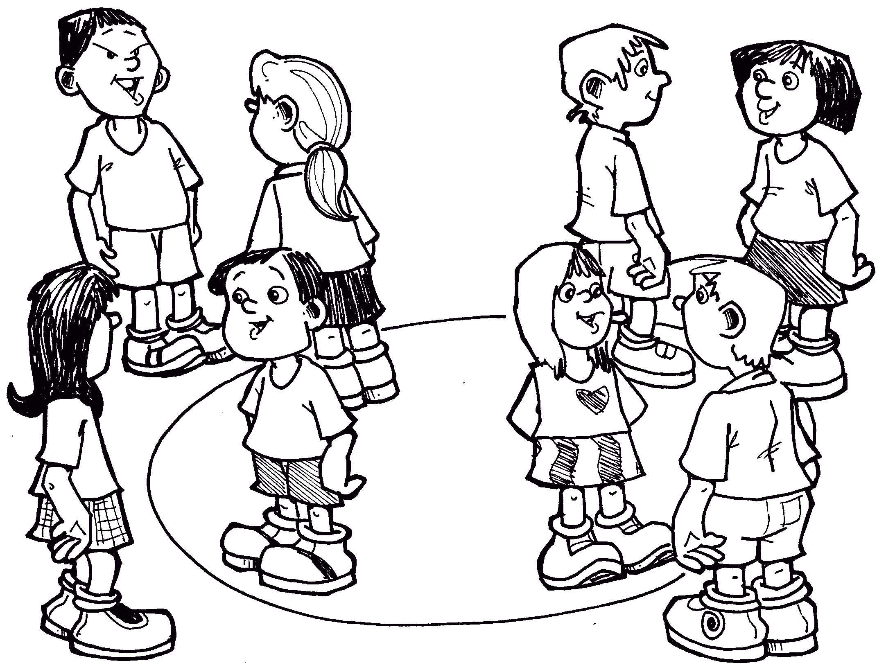
Circle Talk
6. What actions could you take to avoid aggressive drivers?
7. How can you control your own anger when faced with an annoying situation?
8. Is aggressive or abusive behaviour acceptable in any situation? Why?
5. What would you do to make sure the incident didn’t put you and other road users at risk?
1. The community believes that all road users have a responsibility for their own safety and the safety of others. Do you think that all young people believe this too? Why?
4. If you were a learner driver and another driver acted aggressively towards you while driving, how would you feel?
3. What are the characteristics of a tolerant driver? An aggressive driver? What do their actions look and feel like?
2. Some drivers believe it is their right to intimidate other drivers. The media refers this as ‘road rage’. Why do some drivers act in this way?
Notes:
Activity 2.1
Page 34
PROCESS
1. Continue the discussion about road user responsibilities and behaviours by asking the following questions.
• The community believes that all road users have a responsibility for their own safety and the safety of others. Do you think that all young people believe this too? Why?
• Some drivers believe it is their right to intimidate other drivers. The media refers to this as ‘road rage’. Why do some drivers act in this way?
• What are the characteristics of a tolerant driver? An aggressive driver? What do their actions look and feel like?
• If you were a learner driver and another driver acted aggressively towards you while driving, how would you feel?
• What would you do to make sure the incident didn’t put you and other road users at risk? (Stay calm, pull over and allow the other driver to continue. If being physically threatened, stay in the car and call the police. If possible, record the other driver’s registration and vehicle details and report this to the police).
• What actions could you take to avoid aggressive drivers? (Do not respond to the other driver. Avoid any escalation of conflict. Avoid eye contact with the aggressive driver or occupants of the vehicle).
• What actions could you take to become a tolerant and calm driver? (Regulate your emotions and promote being a calm, patient and courteous driver. Regularly practise mindfulness techniques such as breathing exercises and simple meditation. Plan your drive so you know where you are going. Try not to be in a rush – leave enough time to get where you have to go so you are not feeling stressed behind the wheel. Try not to drive when overtired, angry, stressed or upset).
• How can you control your own anger when faced with an annoying situation?
• Is aggressive or abusive behaviour acceptable in any situation? Why?
Further information:
Aggressive Driving and Behaviour – DoT Drive Safe handbook PAGE 93 [4.5 Aggressive driving and behaviour]

Slide 5
Road User Responsibilities
Responsible driving and compliance with the road rules will enable drivers to enjoy the privileges and freedoms of having a driver’s licence.
Let’s identify the key responsibilities of a learner driver, provisional driver, full licence driver and their passengers.
What are your responsibilities as a L driver?
What are your responsibilities as a passenger?
What are your responsibilities as a red and green P plate driver?
What are your responsibilities as a driver on a full licence?
Notes:
Page 36
Multiple strategies can be used to execute this activity.
ie. Fold and tear; graffiti walk; think, pair share etc.

Slide 6
Reflection
Driver pledge
I aim to be a driver who is:
-
-
-
Eg: calm, respectful, safe etc.
Notes:
Page 35
REFLECT
1. Ask students to consider the type of driver they want to be and come up with
three adjectives to describe this eg calm, respectful, safe etc.
Needs circles updated
Potential to combine Activity 2.1 with Activity 4.2 Sharing The Road page 79 [KFL Teacher Resource] and Activity sheet Staying Safe page 81 [KFL Teacher Resource]

Slide 7

Activity 2.2 Responsibilities and Consequences
Page 37-43
Learning intention
Understand consequences of road crashes.
Road Safety Commission – Distance of Distraction Prams
Notes:
Remind students re: shared classroom environment agreements (i.e. safe and supportive); in addition to road trauma and procedure if material presented triggers an emotional response etc. [Road Trauma Council WA available].
Mention lesson learning intention
View video* to engage students into the lesson and trigger discussion on the following slide.
Q. What driving responsibilities did the video highlight?
Q. What consequences could happen if a driver was inattentive?
Q. How could a driver maintain concentration and focus when driving?
*Next slide = discussions on additional responsibilities that a driver and passenger have as road users.
*Adapt video to meet classroom context/student needs. Culturally responsive videos available at ……… Take time to view video prior to lesson delivery to ensure key messaging align with lesson intent and overall outcome expectations from student engagement in lesson.

Slide 8
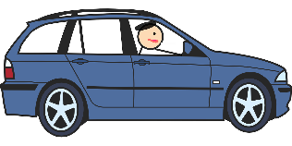

Responsibilities and Consequences
Driver responsibilities
Consequences of not being responsible
Learn and practice safe driving habits (i.e. travel at posted speeds)
Legally obtain a driver’s licence
Obey the law/road rules
Show courtesy and respect to all road users
Loss of licence
Demerit points and fines
Injury to self and others
Jail sentence
Criminal record
What about the passengers?
What are their responsibilities?
What are the potential consequence of passengers not being responsible
Notes:
Page 39
REVISE
1. Groups draw and label a T chart (page 171) on a sheet of A3 paper with the headings shown below.
Driver responsibilities Consequences of not being responsible
2. Ask students to write a list of driver responsibilities in the corresponding column of the T chart. Some examples have been provided.
Alternatively: Post it – each student place an answer on a post it and put onto white board

Slide 9


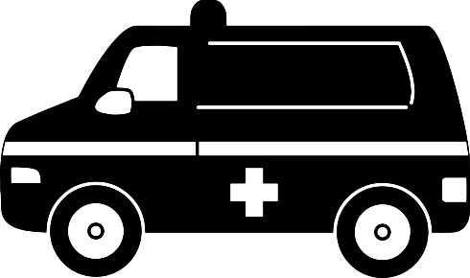
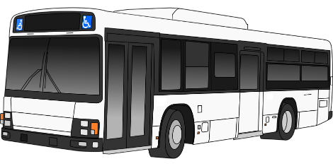


Sharing The Road with Respect
Cyclists
Heavy haulage & oversized vehicles
Let’s look at how a driver can respectfully share the road with the following groups of road users.
Emergency responders & breakdown vehicles
Other vehicles & buses
Roadwork activities
Pedestrians
Notes:
***Additional Activity:
Potential to follow Activity 2.1 with Activity 4.2 Sharing The Road [KFL Teacher Resource] and Activity sheet Staying Safe page 81 [KFL Teacher Resource]
Potential to link a video to one of these (i.e. heavy haulage etc)
THIS SLIDE COULD BE MOVED TO LESSON/ACTIVITY 4.2 IN KFL TEACHER RESOURCE [PAGE 79-80] – Learning intention is to recognise the importance of being a safe, tolerant and courteous road user. LINKS to LESSON 2’s learning intention around driver responsibilities.
JIGSAW activity with focus activity sheet with reflection questions. This is an additional activity not from the teacher resource. Students to use DoT Drive Safe Handbook with accompanying weblinks identified in the notes below.
1. Other vehicles and buses Overtaking (www.wa.gov.au):
Buses & Taxis – DoT Drive safe book page 50 [3.16 Buses & Taxis]; Overtaking vehicles DoT Drive Safe handbook PAGES 71-72 [3.16 Overtaking] Overtaking - Get Street-Wise (rsc.wa.gov.au)
2. Cyclists Cyclists - WA Road Rules (rsc.wa.gov.au) & Might Be A Mate (www.wa.gov.au) DoT Drive Safe PAGES 106 [6.1 Cyclists] & PAGES 21 [1.8.3 Cyclists and motorcyclists] Cyclists/Share the roads - Get Street-Wise (rsc.wa.gov.au)
3. Pedestrians Pedestrians - Get Street-Wise (rsc.wa.gov.au) DoT Drive Safe PAGES 18-20 [1.8.1 Pedestrians]
4. Overtaking large and oversized vehicles Bigger than you (mainroads.wa.gov.au) DoT Drive Safe PAGES 72-74 [3.16 Overtaking]
5.Emergency responder/breakdown vehicles: Slow down, move over More road rules and penalties (www.wa.gov.au). DoT Drive Safe PAGES 41-42 [3.1.2 Passing incident response vehicles] Emergency vehicle - Get Street-Wise (rsc.wa.gov.au)
6. Roadworks – Temporary speed limits; Roadwork sites; temporary traffic control; signals and devices for forad works and special purposes. Updated information in DoT Drive Safe handbook page 41 & 53 – March/April 2022

Slide 10

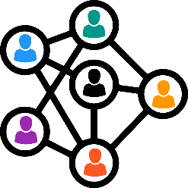


Road Crashes - Consequences
When a road crash happens, there are subsequent consequences that occur. These can be grouped into five different types of consequences.
Legal
Types of consequences
Social
Emotional
Are these consequences relevant to just the vehicle occupants (i.e. driver, passenger?
Who else can be impacted by a crash?
Financial
Physical
Notes:
Grouping consequences activity [pages 40-42]

Slide 11
Road Crashes - Consequences
When a road crash happens, there are subsequent consequences that occur. These can be grouped into seven different types of consequences.
Figure 26.3 Strong Spirit Strong Mind: The Seven Areas used with permission by
Casey, W (2014) Strong Spirit Strong Mind Model – Informing Policy and Practice in Chapter 26 in Dudgeon P, Milroy H & Walker R. 2014, Working Together: Aboriginal and Torres Strait Islander Mental Health and Wellbeing Principles and Practice. Canberra: Australian Government Department of the Prime Minister and Cabinet, 2nd ed., pp.449-458.
Notes:
Page39
Alternative model for indigenous class members: The 2nd Edition of Working Together: Aboriginal and Torres Strait Islander Mental Health and Wellbeing Principles and Practice (eds Pat Dudgeon, Helen Milroy and Roz Walker). Published in 2014, Working Together was funded by the Australian Government Department of the Prime Minister and Cabinet, Telethon Kids Institute/Kulunga Aboriginal Research Development Unit in collaboration with the University of Western Australia.
www.telethonkids.org.au%2Fglobalassets%2Fmedia%2Fdocuments%2Faboriginal-health%2Fworking-together-second-edition%2Fworking-together-aboriginal-and-wellbeing-2014.pdf&clen=14853245&chunk=true
Casey W, Keen J. Strong Spirit Strong Mind: Aboriginal Alcohol and other drugs Worker Resource: A Guide to working with our people, families and communities. Government of Western Australia, Drug and Alcohol Office. Perth, Western Australia, 2005.
The Seven L’s or Seven Areas Model
Grief and Loss – (Loss) Many Aboriginal people experience daily grief and loss on a daily basis: they might use alcohol and other drugs to cope with: Family and friends passing away• Loss of family connections due to stolen generation issues • and intergenerational trauma Family members being in jail• Painful events within family and community
• Country – (Land) Alcohol and other drug use can prevent people from looking after their country. Some people do not have access to traditional lands or sacred sites and might use substances to cope with being lonely for country.
Aboriginal Law and Culture – (Law) Alcohol and other drug use can lead to: Not keeping social and cultural obligations • Breaking Aboriginal Law or cultural rules: this can cause • further stress Not respecting, learning or teaching culture
Health – (Liver) This refers to all of the health problems caused by alcohol and other drug use. This can include: Body Liver and heart disease Cancers Blood borne viruses, i.e. Hep C and HIV STDs Diabetes Mind and Spirit Depression Anxiety Drug induced psychosis Inner spirit
Family and Community Relationships – (Lover) This includes negative impacts on family and community relationships, including: • • • Fighting – verbal and physical Neglect Stress and worry
Money, Work and Study – (Livelihood) Spending too much money on alcohol and other drugs can lead to other problems such as: • • • • • Can’t buy food for the family Can’t pay bills Asking family/friends for money Unemployment Not finishing school
Problems with the Whiteman’s Law – (Legal) Alcohol and other drug use can lead to problems with the law such as: • • • • • • Drug charges Committing crimes – i.e. assault, theft Manslaughter Drink driving Fines Jail

Slide 12
Scenario
You and your mates have had a few beers. Everyone gets in your car to go for a ride. Out on the road your mates get really loud and start to shout and muck around. You try to concentrate but you’ve had too much to drink. Your car starts to skid on the gravel and you lose control. Two of your mates are killed.
Notes:
Page 39

Slide 13
Grouping Consequences Post Activity Discussion
Which consequences (i.e. physical, emotional, legal, social or financial had the most cards?
Would knowing the financial and legal consequences of a crash change the ways a young driver might use the roads? Why/Why not?
The community wants young people to consider the consequences of poor driving decisions.
How could this be achieved?
Why might opinions differ from person to person?
What changes would someone need to make if they no longer had a driver’s licence or access to a vehicle?
Which consequences of road crashes do most young people think about? Why?
How would repaying thousands of dollars of expenses, not covered by insurance, impact someone’s life?
Notes:
Page 38 PROCESS
1. Generate discussion on the following selected questions.
Circle talk; graffiti; think pair share; whole class etc.

Slide 14

Impacts and Consequences
Every driver will respond differently when responding to the consequences of their actions.
Some consequences can have a greater impact and some, little impact.
Scenario
A newly licenced driver has been involved in a crash. The crash was their fault as they had been speeding and overtaking another vehicle when it wasn’t safe to do so. The crash resulted in a serious injury to the occupant of the other vehicle. The newly licenced driver did not have insurance cover.
Least impact
Greatest impact
Notes:
Page 38/39
Alternative processing activity
Read out the scenario and pose the following questions to the class in either pairs, small groups or whole class:
Reflect on the given scenario and list 1-2 examples for each of the five consequences.
Rank the consequences in relation to the impact they would have on the newly licenced driver.
Was it easier or difficult to rank the consequences? Why/Why not?
What particular group of consequences (i.e. financial, social, legal, physical and emotional) was ranked higher. Why is this do you think?
What behaviours could have the newly licenced driver engaged in to reduce the risk of the crash from occurring.
If there were passengers – what could they have done to reduce the risk of the crash occurring.

Slide 15

Reflection
Passenger pledge
I aim to be a passenger who is:
-
-
-
Eg: calm, respectful, safe etc.
Notes:
Additional Activity

Slide 16

Activity 2.3
Learning the road rules
Pages 44-61
Learning intention
Apply road rules to different situations
Road Safety Commission 154 Wrecking Ball 30s v3
Notes:
Remind students re: shared classroom environment agreements (i.e. safe and supportive); in addition to road trauma and procedure if material presented triggers an emotional response etc. [Road Trauma Council WA available].
Mention lesson learning intention
View video* to engage students into the lesson and trigger discussion on the following slide.
Q. Why is it important to follow the road rules?
Q. What factors could influence a drivers not to follow the road rules?
Q. What are some ways that might help a learner driver learn the road rules (in particular prepare for the Learner Permit theory test)?
*Adapt video to meet classroom context/student needs. Culturally responsive videos available at ……… Take time to view video prior to lesson delivery to ensure key messaging align with lesson intent and overall outcome expectations from student engagement in lesson.

Slide 17

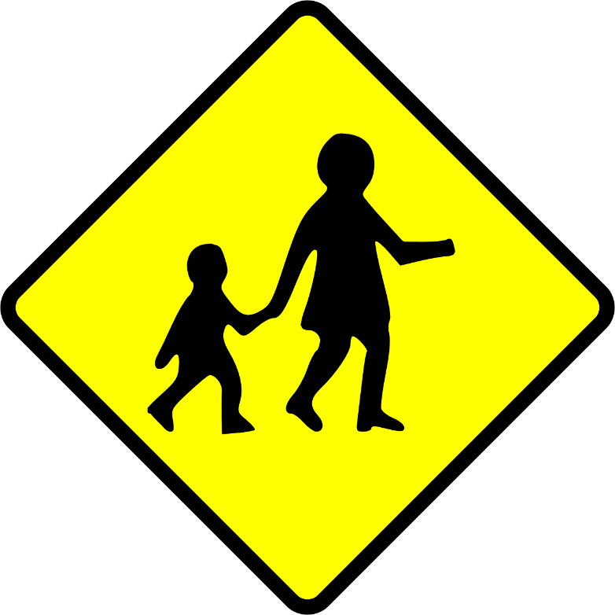
Cryptic Signs – What am I?
Department of Transport: Drive Safe: https://www.transport.wa.gov.au/mediaFiles/licensing/DVS_DL_B_DriveSafeFull_o.pdf
Notes:
Page 45
Solutions
School zone.
Pedestrian crossing.
Roundabout.
Keep left.
T-junction.
Speed limit.
Slippery when wet.
Stop sign.
Winding road.
U turn.

Slide 18
Drive Safe Bingo
Pre Driver Checks:
Tyres
Brakes
Steering
Lights
Horn
Windscreen & wipers
Mirrors
Page 26
It is an offence not to give way to an emergency vehicle.
Page 93
for a car (C class) licence
Page 29
The distance that you can see ahead and to the side is severely reduced after dark.
Page 45
Double continuous unbroken lines
are used as dividing lines (centre lines) on roads. YOU must not cross these lines to overtake but you can cross them to turn right at an intersection, ‘U’ turn or enter or leave a road if it is safe to do so.
Page 56
A way of estimating what is an adequate following distance is to use what is called the ‘two second’ rule.
Page 43
The time it takes to stop a car depends on:
reaction distance and
Braking distance
Page 44
In a ‘built-up’ area, the ‘default’ speed limit is 50 km/h unless a sign shows a different speed.
Page 40
Step 5 – Practical driving assessment (PDA)
Page 32
0.00 per cent BAC You must not drink any alcoholic drinks at all if you intend to drive.
Page 7
3.10.3 Pelican signals
A pelican crossing works like normal traffic control signals, except that it h
as
an extra phase –a flashing yellow light.
Page 60
A controlled intersection is an intersection that has:
traffic control signals;
a ‘STOP’ or ‘GIVE WAY’ sign;
a roundabout; or
a Police Officer or other authorised person directing traffic.
Page 66
Notes:
Activity page 44 solutions Left to right each row
Drive Safe Edition 11

Slide 19
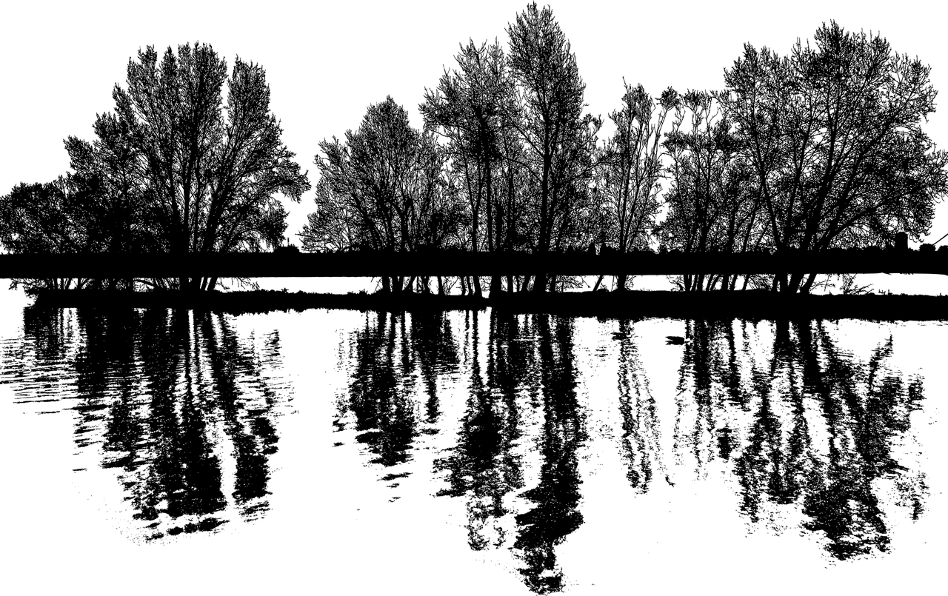
Reflection
Notes:
Page 47

Slide 20
Behind the wheel – Quiz 3 – Indicating and hand signals (page 22); Quiz 4 – Intersections and turning (page 23); Quiz 5 – Traffic signals and road markings (page 24); Quiz 6 – Traffic signals (page 25)
OR use Quizzes 1-5 in the Keys4Life student workbook.
Behind the Wheel Journal
TASK 3: Tolerance and courtesy
page 6
Student Workbook
What sort of driver do you want to be?
page 3
Notes:
Page 47
Have students complete the following quizzes in the Behind the wheel journal.
• Quiz 3 – Indicating and hand signals (page 22)
• Quiz 4 – Intersections and turning (page 23)
• Quiz 5 – Traffic signals and road markings (page 24)
• Quiz 6 – Traffic signals (page 25)

Slide 21
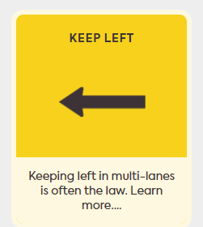
Road Rule: Keeping Left
Keep Left (Road Safety Commission)
Notes:
*If time exists – spending 10min highlighting a particular road rule.
Keep left - Get Street-Wise (rsc.wa.gov.au)
Discuss with class the process for keeping left
Acknowledge the consequence of not keeping left correctly
Complete the quiz.

Slide 22
Road driving vocabulary
Create a list of unfamiliar words – they might come up in the theory test!
Blinkers (indicator)
Infringement (against the road rules)
Provisional driver (P plater)
Traffic control signals (lights)
Pedestrian crossing (person walking)
Cyclist (push bike rider)
Collision (crash)
Notes:
Literacy
Build a vocab list to help familiarise students with words they may encounter in the L theory test; add to spelling list.

Slide 23
Find out more
From the Keys 4 Life teacher resource 2020 edition 7 Lesson 2
If necessary, refer students to the Road Trauma Support WA (RTSWA), a free counselling and advice service available at: http://www.rtswa.org.au/.
Department of Transport Road rules theory test quiz https://www.transport.wa.gov.au/licensing/roadrules-theory-test-quiz.asp
Road Safety Commission 12 Most asked about road rules (Videos, explanations and penalties) https://roadrules.rsc.wa.gov.au/
Department of Transport handbook https://www.transport.wa.gov.au/licensing/learner-activities-and-resources.asp
Road Safety Commission Pre-trip preparation 101 (20 secs) https://roadrules.rsc.wa.gov.au/
https://www.youtube.com/watch?time_continue=7&v=S6Mpb6J49vc
Road Safety Commission Slow down, Move Over (SLOMO) https://www.rsc.wa.gov.au/Rules-Penalties/Browse/Emergency-Vehicles

Slide 24
Website links from resource
From the Keys 4 Life teacher resource 2020 edition 7
Students practise test questions with a parent or adult family member, using the eleven online sample quizzes at https://www.transport.wa.gov.au/licensing/road-rules-theory-test-quiz.asp
Your Secure Identity (https://www.transport.wa.gov.au/licensing/proof-of-identity.asp) describes the five (5) forms of identity required for the application process, of which:
FIND OUT MORE Department of Transport Road rules theory test quiz https://www.transport.wa.gov.au/licensing/road-rules-theory-test-quiz.asp

Slide 25
For teachers /agencies only
Teachers register for the Portal by creating an access account at https://keys4life.ziparchive.com.au/.
Have your Keys4Life Access Number ready and use it to log in to: www.northsidelogistics.com.au
The Agency order form is available at: www.sdera.wa.edu.au/programs/keys4life/

